Slide 1
Stroke Patient Healthcare Analysis Using Deep Learning
Leveraging Data Insights and Predictive Modeling
Presented By: Divyansh

Slide 2

agenda
Introduction
Problem Definition
Data Overview
Exploratory Data Analysis
Data Transformation
Machine Learning Models
Model Evaluation
Visualizing Predictions
Key Observations
Conclusion

Slide 3

Introduction
Objective:
Analyze stroke-related healthcare data to identify trends, insights, and build predictive models.
Dataset Description:
Patient records with 11 features including medical history, demographics, and lifestyle factors.
Key Variables:
Age, BMI, Hypertension, Heart Disease, Smoking Status, Work Type, Residence Type, Stroke Incidence.
Goal:
Enhance understanding of stroke predictors for better healthcare interventions.

Slide 4

Problem Definition
Challenges Addressed:
Identifying relationships between health metrics and stroke occurrences.
Building models to predict stroke incidences based on available data.
Approach:
Data exploration, preprocessing, visualization, encoding, and machine learning modeling.

Slide 5
Data Overview
Dataset Size: 5110 entries, 12 columns.
Key Observations:
Missing BMI values (3.93%) handled using median imputation.
Categorical columns encoded into binary features.
Preprocessing Highlights:
Null handling for BMI.
Binary encoding for Residence Type, Work Type, and Smoking Status.
Creation of a clean, encoded dataset for modeling.

Slide 6
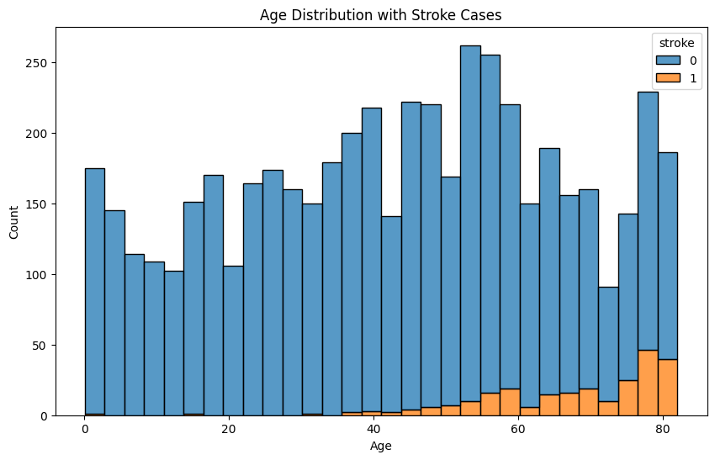
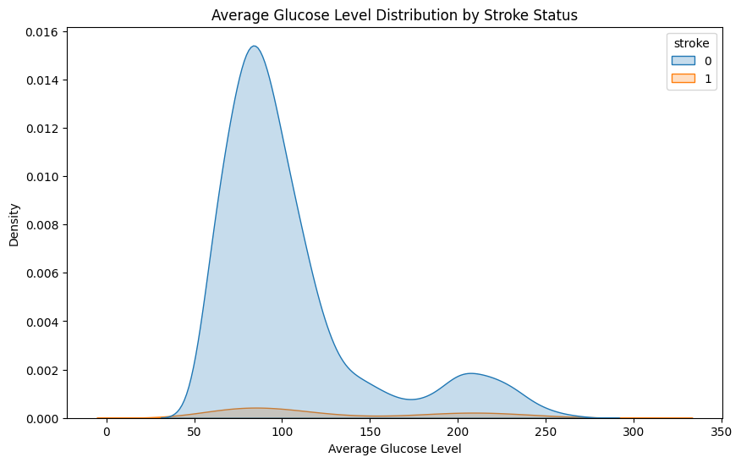
Exploratory Data Analysis
Age Distribution:
Stroke cases predominantly in older age groups.
Glucose Level:
Higher glucose levels correlate with stroke cases.

Slide 7
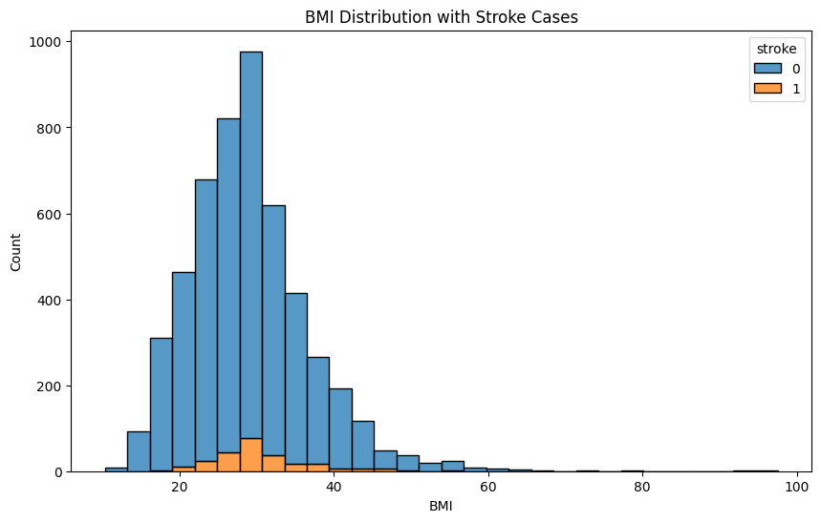
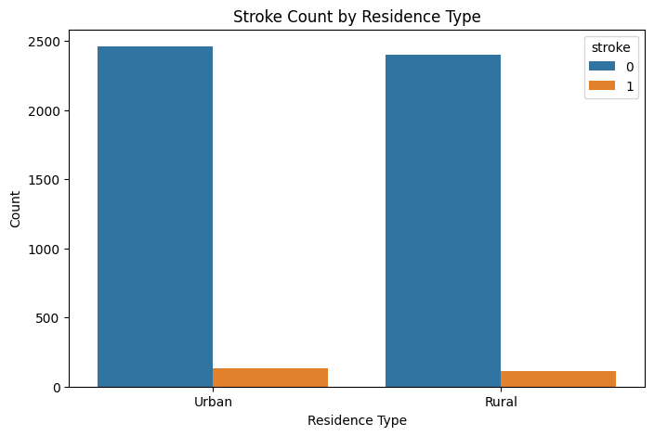
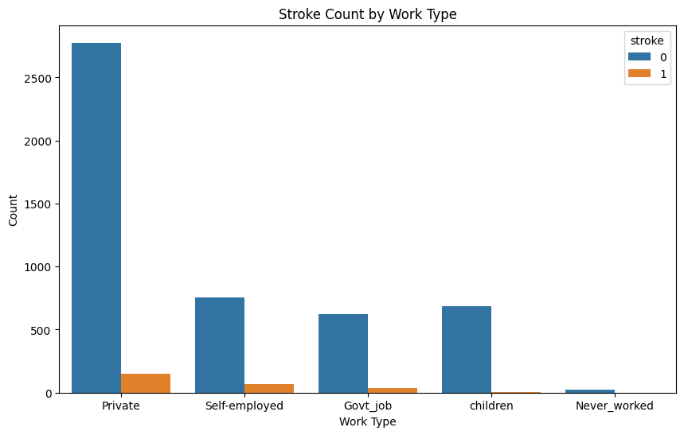
BMI Analysis:
Variation in BMI between stroke and non-stroke cases
Residence:
Urban residents show higher stroke counts.
Work Type Impact:
Stroke cases are higher among private-sector workers.

Slide 8
Data Transformation
Encoding Strategy:
Converted categorical columns to binary:
Residence (Urban = 1, Rural = 0).
Work Type (5 categories to binary).
Smoking Status (4 categories to binary).
Final Dataset Features:
13 columns after dropping original categorical variables.
Ready for predictive modeling.

Slide 9
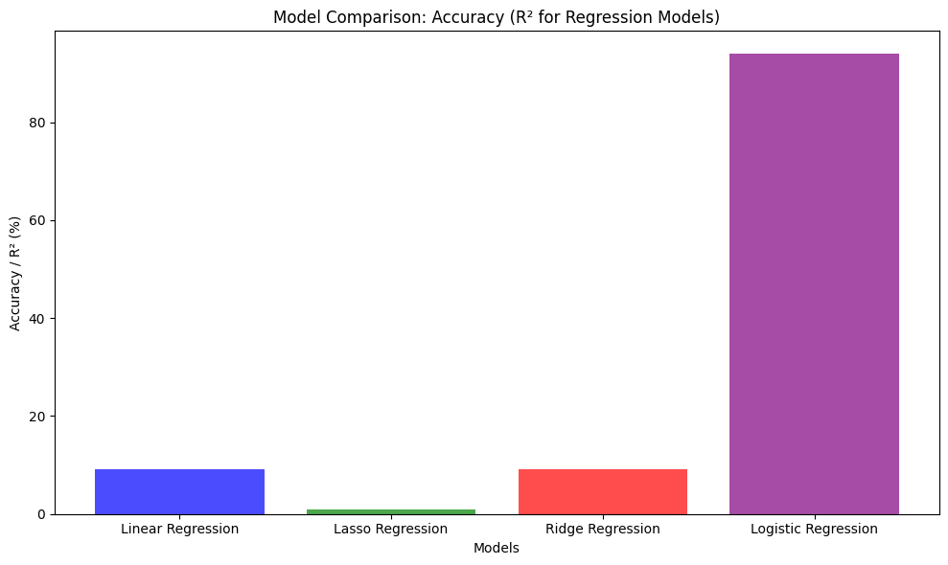
Machine Learning Models
Models Built:
Linear Regression: RMSE: 22.76%, Accuracy: 9.14%.
Lasso Regression: RMSE: 23.76%, Accuracy: 0.94%.
Ridge Regression: RMSE: 22.75%, Accuracy: 9.13%.
Logistic Regression: RMSE: 24.63%, Accuracy: 93.93%.
Observations:
Logistic Regression outperformed other models due to its suitability for binary classification tasks like stroke prediction.

Slide 10
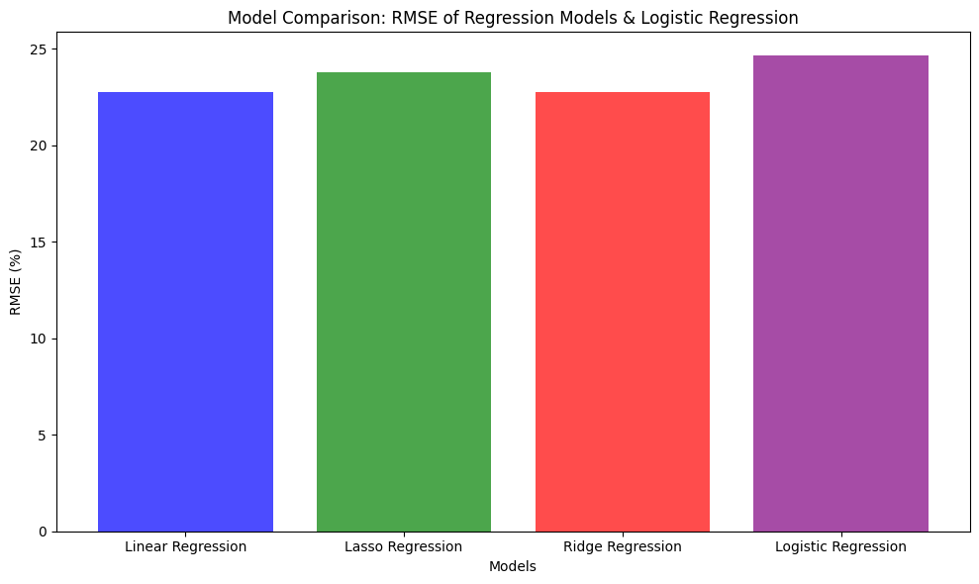
Model Evaluation
Comparison Metrics:
Root Mean Square Error (RMSE).
Accuracy Scores.
Visualizations:
Bar chart comparing RMSE for all models.
Accuracy comparison plot highlighting logistic regression's superior performance.

Slide 11
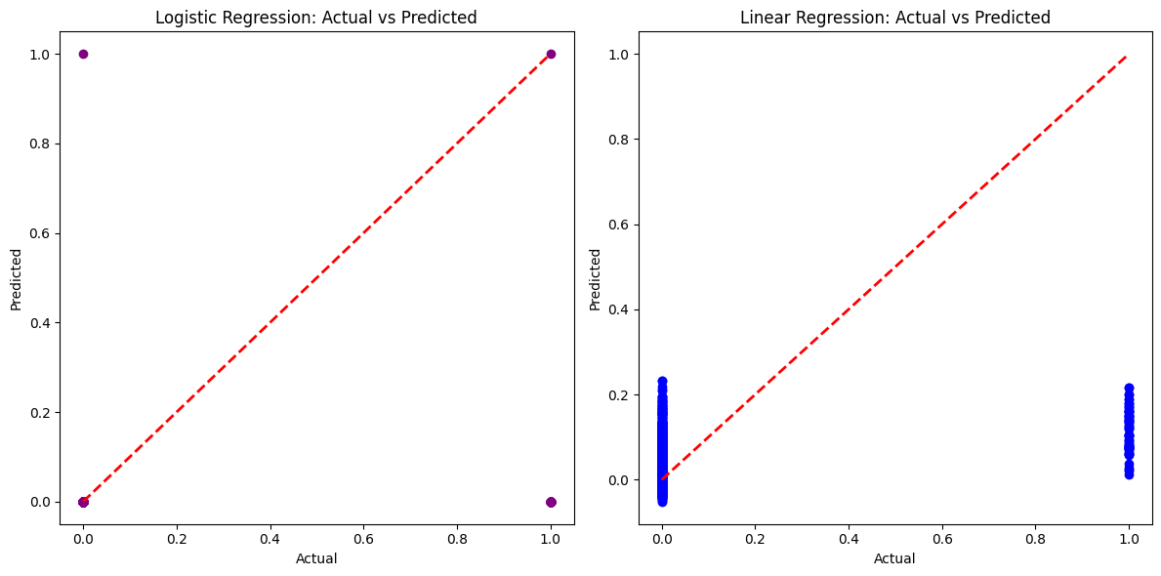
Visualizing Predictions
Model Predictions:
Logistic Regression: Classification model visualization (Actual vs Predicted).
Linear Regression: Regression model visualization (Actual vs Predicted).
Key Takeaways:
Logistic Regression provided the best alignment with actual stroke cases.

Slide 12
Key Observations
EDA Insights:
Stroke cases increase with age and high glucose levels.
Work type and residence type show significant stroke incidence variation.
Modelling Observations:
Logistic Regression is ideal for this problem.
Linear, Lasso, and Ridge Regression have lower accuracies as stroke is a classification problem, not regression.

Slide 13
Conclusion
Finding:
Age, glucose levels, and lifestyle factors are significant predictors of stroke.
Logistic Regression offers a robust predictive model with 93.93% accuracy.
Future Work:
Explore advanced models like Random Forests and Neural Networks for further optimization.
Collect additional data for underrepresented groups (e.g., rural and younger populations).

Slide 14

Thank you
Presented By: Divyansh
Infosys Spring board Intern

